Slide 1
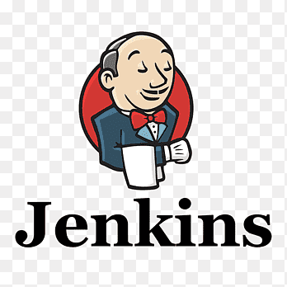
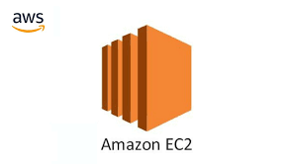
Automating EC2 Instance Creation with Jenkins Pipeline and Maven Integration

Slide 2
Introduction:
This document outlines the steps required to automate the creation of an AWS EC2 instance using a Jenkins pipeline integrated with Maven plugin.

Slide 3
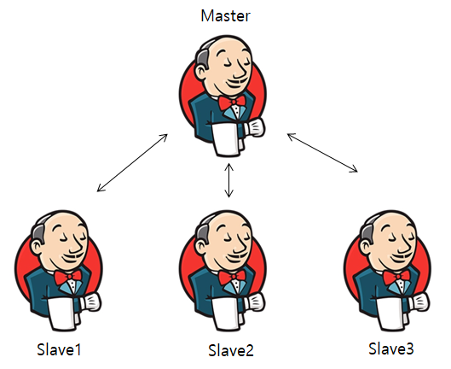
What is Jenkins?
Jenkins is an open-source automation server commonly used for continuous integration (CI) and continuous delivery (CD) in software development. It allows developers to build, test, and deploy applications automatically, facilitating a faster development cycle.
Here Jenkins master distributes the work to Jenkins slave1, slave2,slave3 based on requirement.

Slide 4
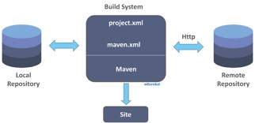
What is maven?
Maven is a build automation and project management tool primarily used for Java projects. It simplifies the process of building, managing dependencies, and deploying applications by providing a standardized way to define project structures and configurations.

Slide 5
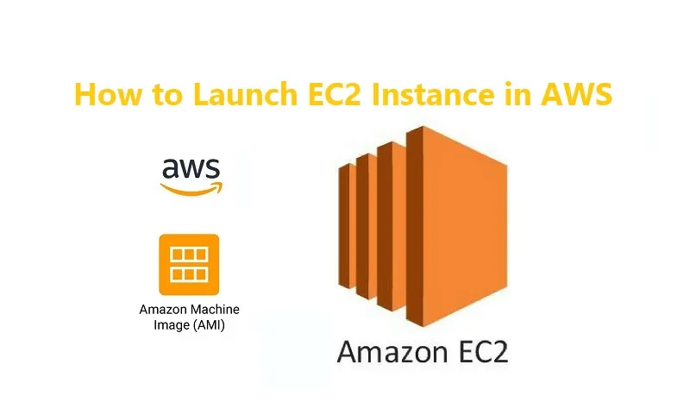
What is EC2?
EC2 stands for Amazon Elastic Compute Cloud, a web service that allows users to host virtual servers in the cloud.
EC2 provides secure, resizable compute capacity in the cloud, making it easier for developers to perform web-scale cloud computing

Slide 6
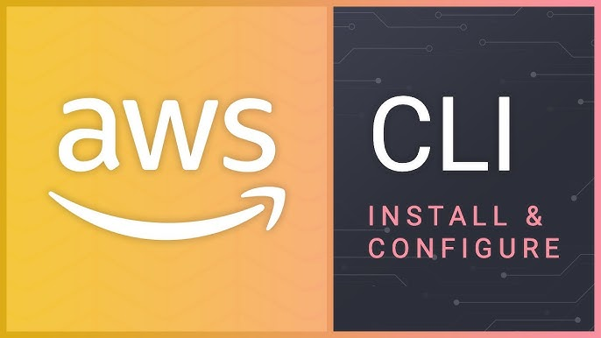
What is AWS CLI?
The AWS Command Line Interface (CLI) is a powerful tool that allows users to interact with Amazon Web Services (AWS) services using command-line commands. It provides a unified interface for managing AWS resources, enabling developers and system administrators to automate their workflows and manage their infrastructure efficiently.

Slide 7
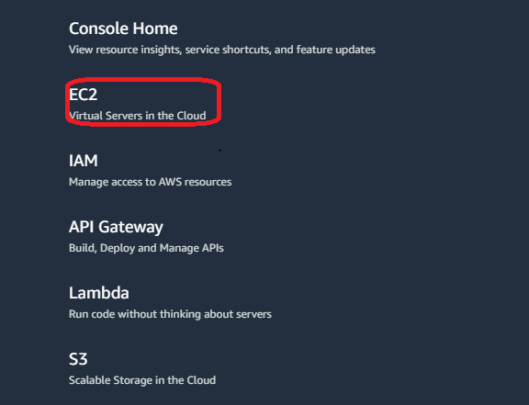
Prerequisites:
A.AWS Account Setup
1.Sign in to the AWS Management Console.
2.Click on the ec2 service

Slide 8
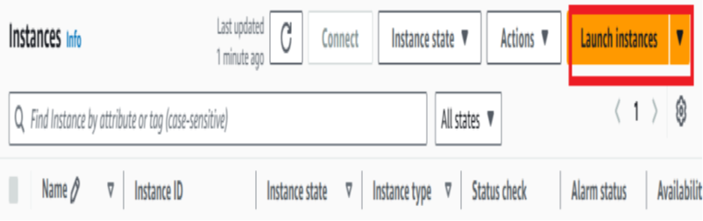
Go to ec2 dashboard and click on the launch instance.

Slide 9
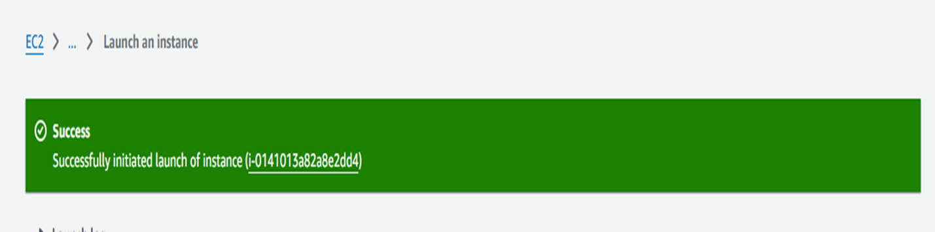
click on the launch instance: 1.Give the instance name(any name) 2.select the AMI NAME(UBUNTU free-tier) 3.select the instance type(t2.micro) 4.select the keypair (select or create new key) 5.select the network settings(edit) ssh-http-https-all traffic-all tcp –anywhere 6.auto-signin (disable) 7.launch instance The below image shows that the instance is successfully created.

Slide 10
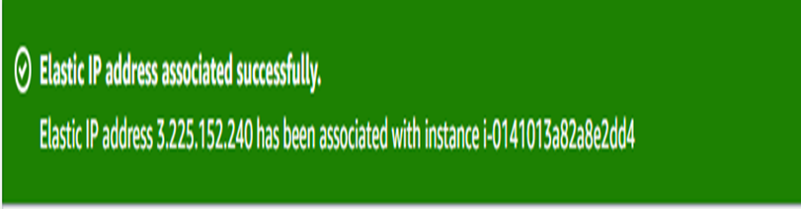
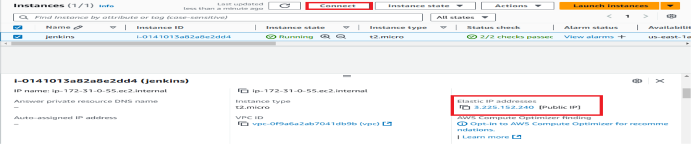
Here we are allocate the ELASTIC IP ADDRESS to the instance the below image shows the Elastic IP address is associated successfully. In instance also the Elastic IP address is associated.

Slide 11
B. Jenkins Installation
1.Connect instance with ssh client(pem file)
2. sudo apt-get update –y
3. go to jenkins.io(downloads-ubuntu)
4. sudo wget -O /usr/share/keyrings/jenkins-keyring.asc \
https://pkg.jenkins.io/debian-stable/jenkins.io-2023.key
5. echo "deb [signed-by=/usr/share/keyrings/jenkins-keyring.asc]" \
https://pkg.jenkins.io/debian-stable binary/ | sudo tee \
/etc/apt/sources.list.d/jenkins.list > /dev/null
6. sudo apt-get update
7. sudo apt-get install fontconfig openjdk-17-jre
8. sudo apt-get install Jenkins
9.sudo systemctl start jenkins
10.sudo systemctl enable Jenkins
11. sudo systemctl status jenkins

Slide 12
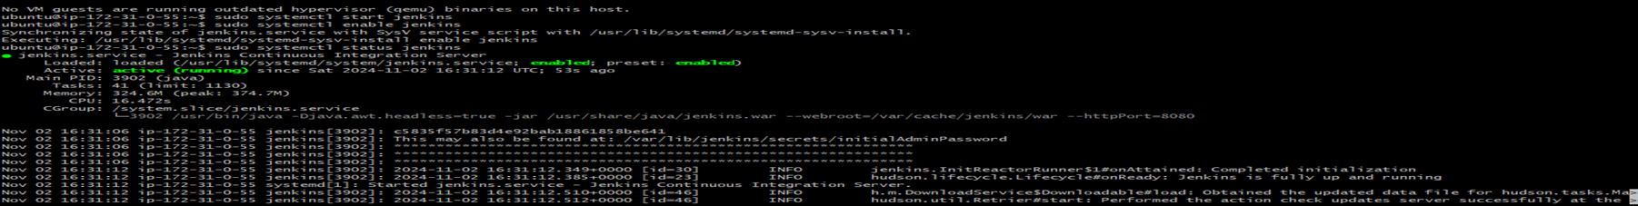
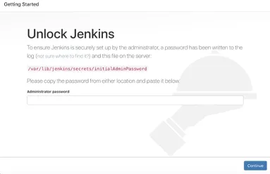
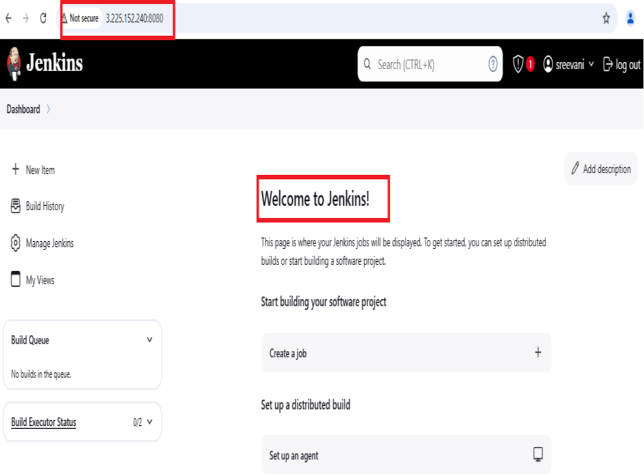
12.copy the running instance elastic ip adress:8080 and paste it on new tab. 13.unlock Jenkins dashboard will come. 14.Copy the var path and paste it on git bash 15.password generate copy and paste it on Jenkins dashboard. 16.start using Jenkins. The below images shows the Jenkins is active running and the Jenkins dashboard is as welcome to Jenkins.

Slide 13
C. Maven Installation:
We have to install the aws cli ,git, maven on the same git bash.
17. sudo apt update
18. sudo apt install unzip curl –y
19. curl "https://awscli.amazonaws.com/awscli-exe-linux-x86_64.zip" -o "awscliv2.zip“
20. unzip awscliv2.zip
21.sudo ./aws/install
22.aws –version
23. sudo apt update
24. sudo apt install git maven –y
25. mvn –version
26. which git The below image shows the maven version and git path.

Slide 14
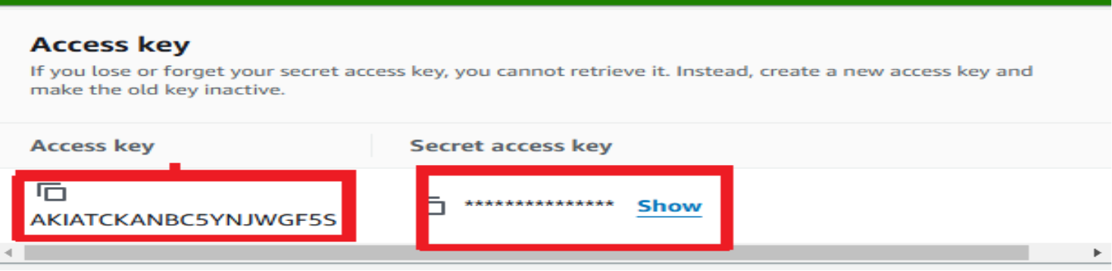
D.Security credentials: Go the aws console sign in right side top click on below options. Go to the security credentials and create the access key and security access key . The below image shows the access key and secret access key is successfully created.

Slide 15
Setting Up Jenkins:
A. Installing Required Plugins
1.Open Jenkins and go to Manage Jenkins.
2. Click on Manage Plugins and navigate to the Available tab
3.Search for and install the following plugins
Pipeline: Enables the creation of Jenkins pipelines.
Amazon EC2: Facilitates interactions with AWS services
Maven Integration: Adds support for Maven projects.
The below image shows the manage Jenkins –plugins– available plugins– install the suggested plugins.

Slide 16
B. Configuring Jenkins Credentials
1.Navigate to Manage Jenkins > Manage Credentials.
2. Click on (global) > Add Credentials.
3. Choose AWS Credentials and enter your Access Key ID and Secret Access Key.
4. Save the credentials and take note of the ID for use in the pipeline script.
The below image shows the aws credentials is successfully added.

Slide 17
Go to manage Jenkins –tools– add maven –name(maven)– version(3.8.7)—apply and save.

Slide 18
4. Creating the Jenkins Pipeline
Pipeline Script Overview
Navigate to New Item in Jenkins and select Pipeline.
Enter a name for your pipeline and click OK.
In the pipeline configuration, use the following script template:

Slide 19
Configure the pipeline as shown below and build now and see the stage view as login to aws and see the console output.

Slide 20
Configure the pipeline as shown below and build now and see the stage view as list ec2 instances and see the console output.

Slide 21
Configure the pipeline as shown below and build now and see the stage view as create ec2 instances and see the console output.

Slide 22
Go to the Jenkins dashboard –ec2Jenkins pipeline—stages. The below image the stages of the pipeline.

Slide 23
Finally the instance is created in the ec2 dashboard. The below image shows the instance is successfully created.

Slide 24
Conclusion:
This document provides a comprehensive guide for automating the creation of an EC2 instance using Jenkins and Maven. By leveraging these tools, developers can significantly enhance their deployment workflows and maintain consistent environments.

